Slide 1
Programming Language and Specification
Weixing Ji

Slide 2
Programming Language Basics
The programming language spectrum
Language Specification

Slide 3


Programming Language
Programming languages are notations for describing computations to people to machines
The evolution of programming language
Machine language, 1940s
What’s advantage and disadvantage?

Slide 4
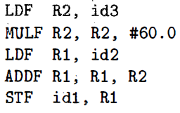
Programming Language
Programming languages are notations for describing computations to people to machines
The evolution of programming language
Mnemonic assembly language, early 1950s
What’s advantage and disadvantage?

Slide 5
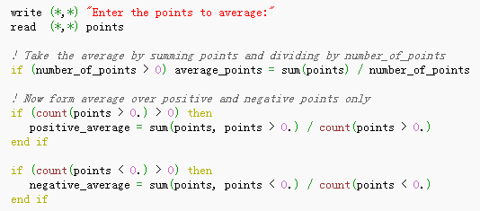
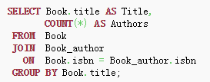

Programming Language
Programming languages are notations for describing computations to people to machines
The evolution of programming language
High level programming language, late half of 1950s
FORTRAN for scientific computing
SQL for business data processing
Lisp for symbolic computation

Slide 6
Programming Language
First-generation languages
Machine languages
Second-generation languages
Assembly languages
Third-generation languages
Higher-level languages: Fortran, Cobol, Lisp, C, C++, C# and Java
Forth-generation languages
Designed for specific application: NOMAD, SQL
Fifth-generation languages
Prolog and OPS5

Slide 7
Programming Language
Imperative language
A program specifies how a computation is to be done
C, C++, Java and C#
There a notion of state and statements that change the state
Declarative language
A program specifies what computation is to be done
ML, SQL

Slide 8
Programming Language
Object-oriented programming languages
A programming style in which a program consists of a collection of objects that interact with one another
Scripting language
Interpreted languages with high-level operators designed for “gluing together "computations
JS, Perl, PHP, Python, Ruby

Slide 9
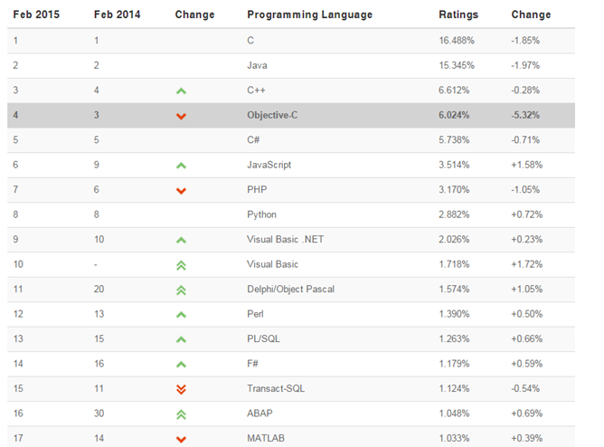
Programming Language Basics
Programming language ratings
http://www.tiobe.com/

Slide 10
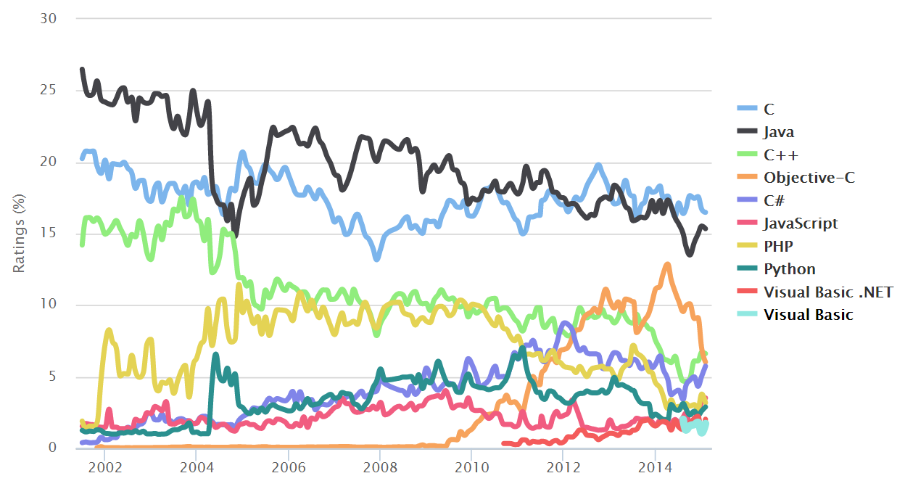
The programming language spectrum
Source: http://www.tiobe.com/

Slide 11
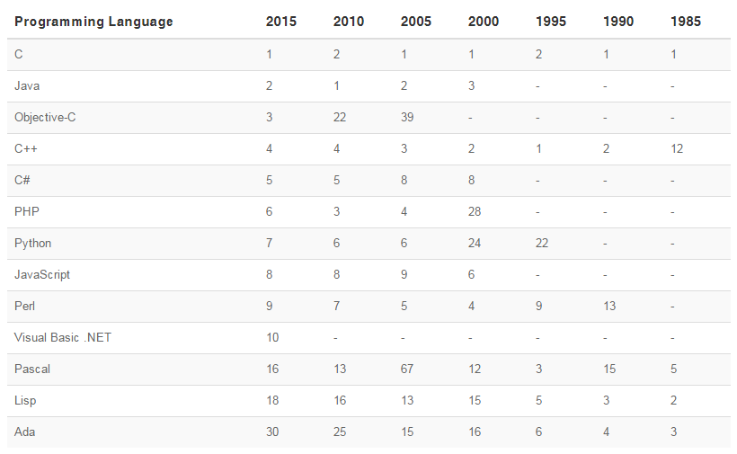
The programming language spectrum
Very long time history
Source: http://www.tiobe.com/

Slide 12
The programming language spectrum
There are thousands of programming language and new ones continue to emerge
Why are there so many programming languages?
What makes a language successful?
Why are there new programming languages?
What a good programming language?

Slide 13
The programming language spectrum
Why are there so many programming languages
Evolution: constantly finding better ways to do things
Special Purpose: many languages were designed for a specific problem domain
Personal Preference: Different people like different things
Notes:
Late 1960s – early 1970s : goto based languages give way to structured programming
Late 1980s: nested block structure of languages give way to object-oriented structure
Lisp is good for manipulating symbolic data and complex data structure
C is good for low-level systems programming
Prolog is good for reasoning about logical relationships among data

Slide 14
The programming language spectrum
Why are there so many programming languages
Application domains have distinctive/conflicting needs
Scientific computing (FORTRAN)
Good FP support
Good arrays
Parallelism
Business applications (SQL)
Persistence
Report generation
Data analysis
System programming (C/C++)
Control of resources
Real time constraints

Slide 15
The programming language spectrum
What makes a language successful?
Expressive power
abstraction facilities in particular
Ease of use for the Novice
very low “learning curve”
Ease of implementation
Could be implemented on tiny machines
Free and Portability
Open source
Excellent compilers
Fortran owes much of its success to extremely good compilers
Others

Slide 16
The programming language spectrum
Why are there new programming language?
Programming training is the dominate cost for a programming language
Widely used programming language are slow to change
Easy to start a new language
Language adopted to fill a void
New languages tend to look like old languages

Slide 17
The programming language spectrum
Overall
Application domains have conflicting needs
It is hard to design one system for all
Programmer training is the dominant cost for a programming language

Slide 18
Language Specification
Unlike natural languages such as English or Chinese, computer languages must be precise
Both their form(syntax) and meaning(semantic) must be specified without ambiguity
both programmers and computers can tell what a program is supposed to do
Language design and implementation
Use formal syntactic and semantic notation

Slide 19
Language Specification
Example
Form (syntax)
digit→ 0 | 1 | 2 | 3 | 4 | 5 | 6 | 7 | 8 | 9
non_zero_digit → 1 | 2 | 3 | 4 | 5 | 6 | 7 | 8 | 9
natural_number → non_zero_digit digit*
Meaning(semantic)
Arabic numerals
Base-10, place-value interpretation
Colors
Days of the week in a decimal calendar

Slide 20
Language Specification
Distinguishing syntax and semantics
Different programming languages often provide features with very similar semantics but very different syntax
There are some very efficient and elegant algorithms that a compiler or interpreter can use to discover the syntactic structure (but not the semantic)
Syntax
Specifying syntax rules → regular expression & context-free grammars
Figure out how (and whether) a given program was built according to these rules → scanners and parsers

Slide 21
Language Specification
Specifying syntax: regular expressions and context-free grammars
Tokens can be constructed from individual characters using just three kind of formal rules
Concatenation
Alternation: choice among a finite set of alternatives
Closure: repetition an arbitrary number of times
Specifying most of the rest of the what we intuitively think of as syntax requires one additional kind of rules
Recursion: create of a construction from simpler instances of the same construct

Slide 22
Language Specification
Specifying syntax: regular expressions and context-free grammars
Any set of strings that can be defined in terms of the first three rules is called a regular set / regular language
Generated by regular expression
Recognized by scanners
Any set of strings that can be defined if we add recursion is called a context-free language
Generated by context-free grammars
Recognized by parsers

Slide 23
Language Specification
Strings and Languages
alphabet: any finite set of symbols
Binary alphabet {0, 1}
ASCII
Unicode
A string over an alphabet is a finite sequence of symbols drawn from that alphabet
In language, sentence = string
The length of a string s : |s|
What’s the length of an empty string?

Slide 24
Language Specification
Terms for parts of strings
A prefix of string s is any string obtained by removing zero or more symbols from the end of s
A suffix of string s is any string obtained by removing zero or more symbols from the beginning of s
A substring of s is obtained by deleting any prefix and any suffix from s
The proper prefixes, suffixes, and substrings of a string s are those, prefixes, suffixes, and substrings, respectively, of s that are not or not equal to s itself

Slide 25
Language Specification
String operations
Concatenation of x and y, denoted xy, is the string formed by appending y to x
Exponentiation, think of concatenation as a product
S^{i} ( i >= 0)

Slide 26
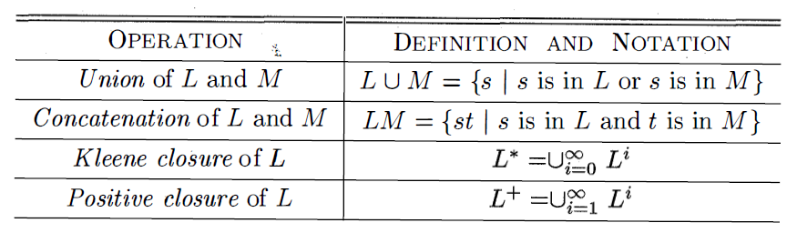
Language Specification
A language is any countable set of strings over some fixed alphabet
Φ, { }, machine language, C, C++, Java, …
Operations on Language
Union, Concatenation, Closure
Notes:
Union is the
fam iliar operation on sets. The concatenation of languages is all strings fo rmed
by taking a string from the first language and a string fr om the second language
, in all possible ways , and concatenating them 􁗩 The (Kleene) closure of a
language L, denoted L*, is the set of strings you get by concatenating L zero
or more times.
Note that LO , the "concatenation of L zero times," is defined to
be {E} , and inductively, L i is L i - 1 L. Finally, the positive closure, denoted L + ,
is the same as the Kleene closure, but without the term LO . That is, E will not
be in L + unless it is in L itself.

Slide 27
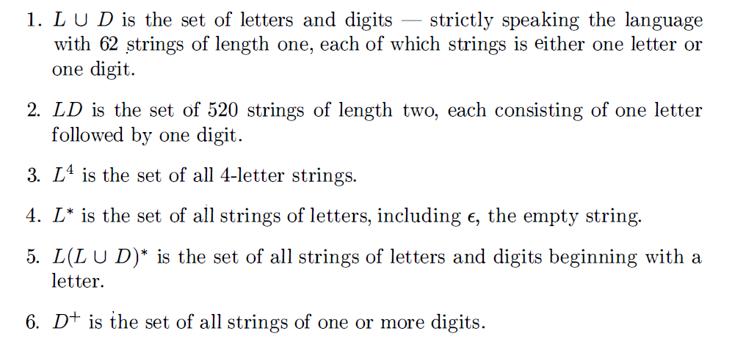
Language Specification
Example
L = {A, B, C, … , a, b, … , z}
D = {0, 1, … , 9}

Slide 28
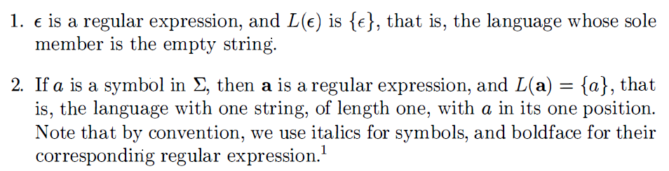
Language Specification
Regular expression
built recursively out of smaller regular expressions
Each regular expression r denotes a language L(r)
L(r) is also defined recursively from the languages denoted by r's sub-expressions
Basic rules

Slide 29
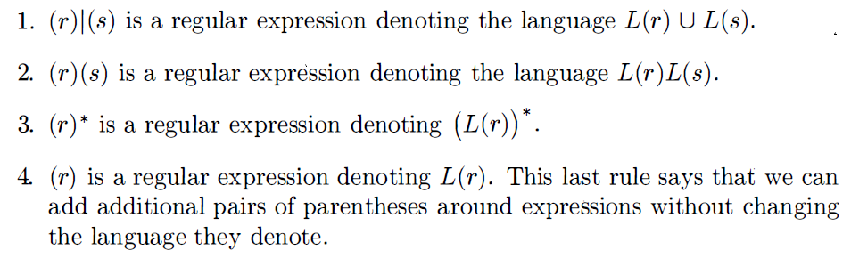
Language Specification
Regular expression
INDUCTION: larger regular expressions are built from smaller ones
Suppose r and s are regular expressions denoting languages L(r) and L(s), respectively

Slide 30
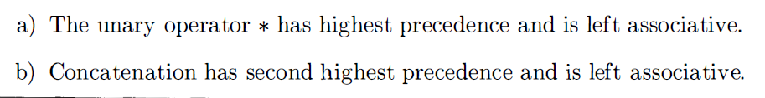
Language Specification
Regular expression
Remove the parentheses
(a)|((b) *(c)) → alb* c

Slide 31
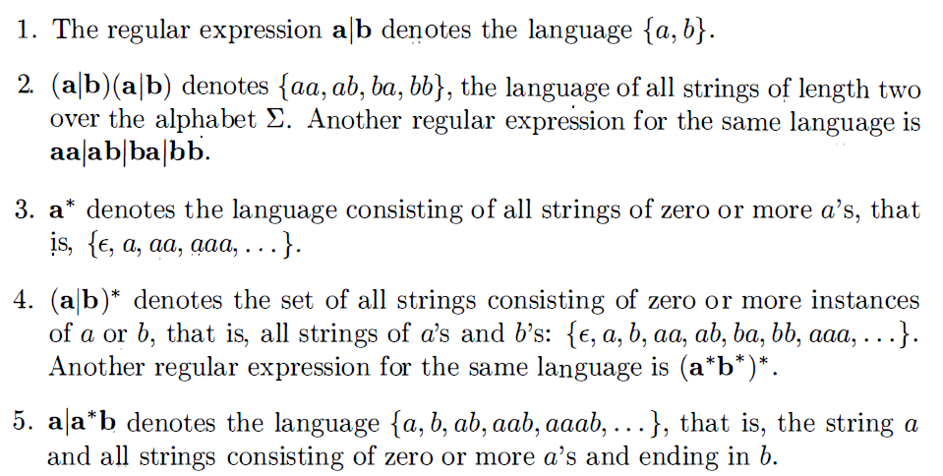
Language Specification
Regular expression
Example: Let = {a, b}

Slide 32
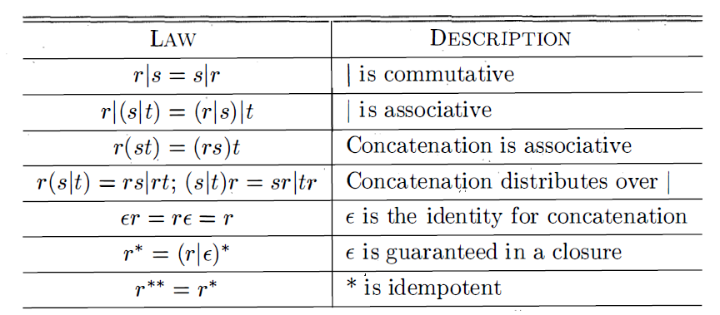
Language Specification
Equivalent regular expression
r = a | b L(r) = ?
r = b | a L(r) = ?
Algebraic laws

Slide 33
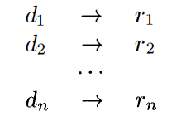
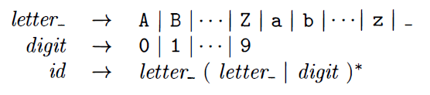
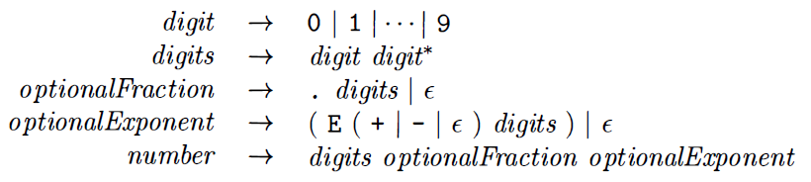
Language Specification
Naming regular expression
for notational convenience
Example – c identifier
Example – unsigned number

Slide 34



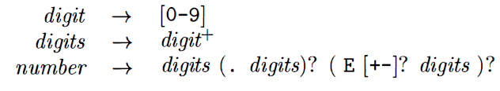
Language Specification
Extensions of Regular Expressions
Kleene introduced regular expressions in 1950s
Extensions have been added to specify string patterns
One or more instance r+
Zero or one instance r?
Character classes
Example

Slide 35
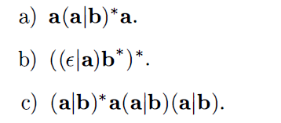
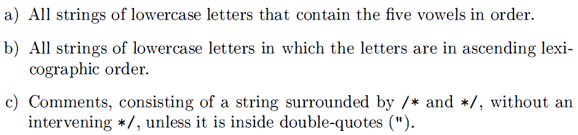
Language Specification
Exercise
Describe the languages denoted by the following regular expressions
Write regular definitions for the following languages

Slide 36
Language Specification
Specifying syntax: regular expressions and context-free grammars
Any set of strings that can be defined in terms of the first three rules is called a regular set / regular language
Generated by regular expression
Recognized by scanners
Any set of strings that can be defined if we add recursion is called a context-free language
Generated by context-free grammars
Recognized by parsers

Slide 37
Language Specification
Context free grammar
specify the syntax of a language
describes the hierarchical structure of most programming language constructs
nonterminal
production
terminal

Slide 38
Language Specification
Context free grammar : four components
A set of terminal symbols(tokens)
A set of nonterminal symbols (syntactic variables)
A set of strings of terminals
A set of production
Consists of a nonterminal, an arrow a sequence of terminals and nonterminals
A designation of one of the nonterminals as the start symbol

Slide 39
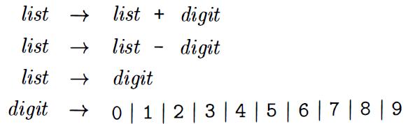
Language Specification
specify grammars by listing their productions
Example :lists of digits separated by plus or minus signs

Slide 40
Language Specification
Context free grammar
a production is for a nonterminal if the nonterminal is the head of the production
A string of terminals is a sequence of zero or more terminals,
Derivation
A grammar derives strings by beginning with the start symbol and repeatedly replacing a nonterminal by the body of a production for that nonterminal
The terminal strings that can be derived from the start symbol form the language defined by the grammar

Slide 41
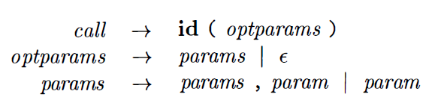
Language Specification
Derivation
Example: function call in Java
Parsing
the problem of taking a string of terminals and figuring out how to derive it from the start symbol of the grammar
reporting syntax errors within the string

Slide 42
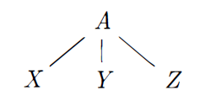
Language Specification
Parse tree
pictorially shows how the start symbol of a grammar derives a string in the language
given a context-free grammar, a parse tree according to the grammar is a tree with the following properties
The root is labeled by the start symbol
Each leaf is labeled by a terminal
Each interior node is labeled by a nonterminal
nonterminal labeling some interior node → production

Slide 43
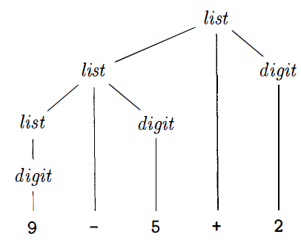

Language Specification
Parse tree
Example

Slide 44

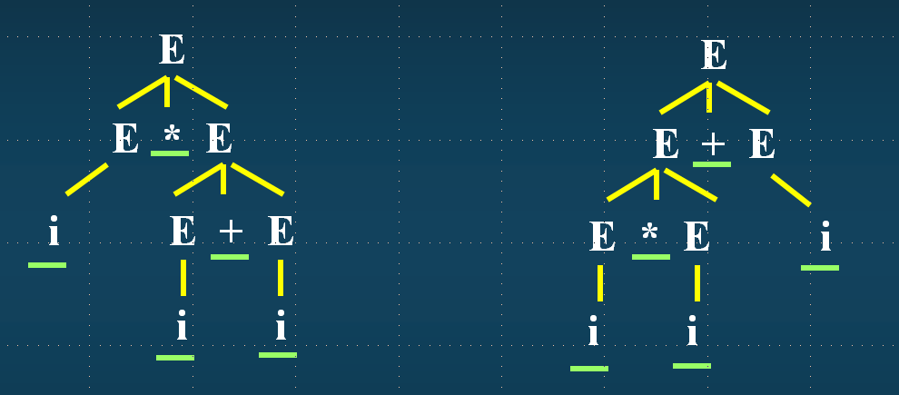
Language Specification
Ambiguity

Slide 45
Language Specification
Ambiguity
A grammar can have more than one parse tree generating a given string of terminals
To show that a grammar is ambiguous
We need to do is find a terminal string that is the yield of more than one parse tree
a string with more than one parse tree usually has more than one meaning
design unambiguous grammars for compiling applications
use ambiguous grammars with additional rules to resolve the ambiguities

Slide 46
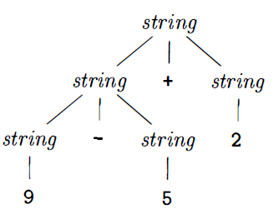
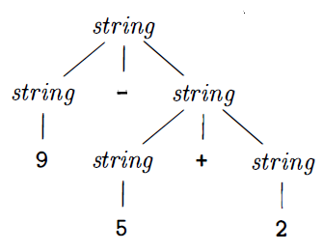


Language Specification
Ambiguity
Example

Slide 47


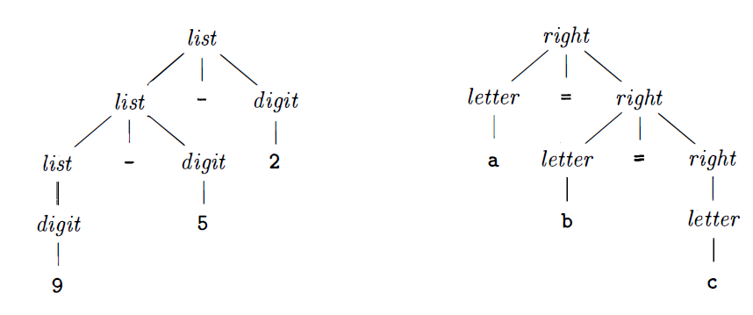
Language Specification
Ambiguity
Associativity of Operators
deciding which operator applies to that operand
Left associative : + - in C
Right associative : = in C

Slide 48


Language Specification
Ambiguity
Precedence of Operators
defining the relative precedence of operators
Notes:
We say that * has higher precedence than + if * takes its operands before +
does.

Slide 49


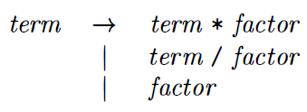
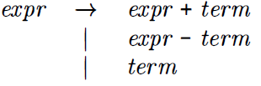
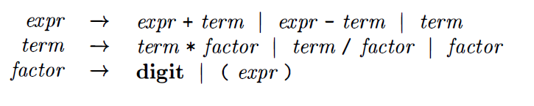
Language Specification
Grammar design
Example: A grammar for arithmetic expressions can be constructed from a table showing the associativity and precedence of operators

Slide 50
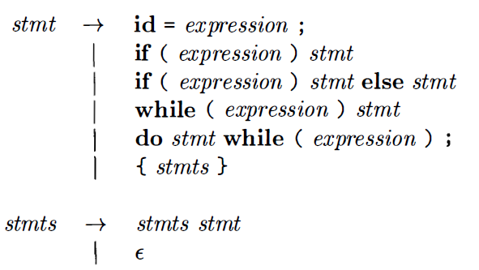
Language Specification
Grammar design
Statements in Java

Slide 51
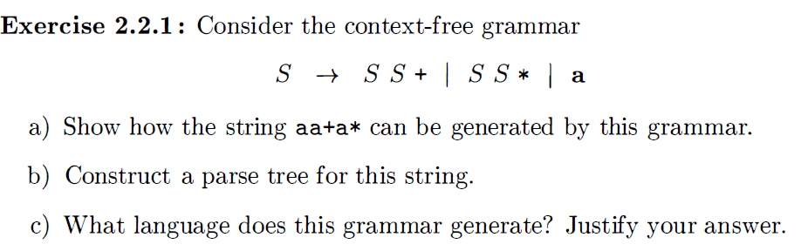
Language Specification
Exercise

Slide 52
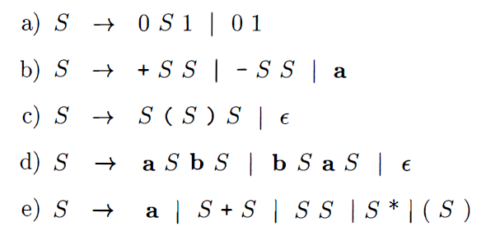
Language Specification
Exercise
What language is generated by the following grammars
Which of the grammars in this Exercise are ambiguous?

Slide 53

Language Specification
Exercise
Construct unambiguous context-free grammars for each of the following languages
Left-associative lists of identifiers separated by commas
Right-associative lists of identifiers separated by commas
Arithmetic expressions of integers and identifiers with the four binary operators +, - , *, /
What’s the language of following grammar?

Slide 54
Language Specification
Tokens: the basic building blocks of programs
Key words : int for while void float
Identifiers: intA funcFoo
Literals: “Hello World” 2.50 6.022e23
Separators: ; ( ) { } ,
operators : + - * / = == :?
Regular expression
A character
The empty string, denoted
Two regular expressions next to each other
Two regular expressions separated by a vertical bar (|)
Regular expression followed by a Kleene star

Slide 55
Language Specification
Regular expression example
0|1|2|3|4|5|6|7|8|9 : digit
(digit) (digit )* : unsigned_interger
((. unsigned_interger) | )(((e | E) (+ | - | ) unsigned_interger) | ) : unsigned_number
Notes:
parentheses

Slide 56
The static/dynamic distinction
What a decision can the compiler make about a program
Language that use static policy allows the compiler to decide an issue --- compile time
Language that use dynamic policy allows a decision to be made when execution – run time
Example in Java
public static int x;

Slide 57
The static/dynamic distinction
Static scope and block structure

Slide 58
Homework
Readings
Chapter 1
Project #1: Language recognization
Implementing the Quick Sort Algorithm in C/C++, Java, Python, Haskell
Ruby
http://tryruby.org/
http://www.ruby-lang.org/
Haskell
http://tryhaskell.org/
http://www.haskell.org/haskellwiki/Haskell
Deadline: March 21st

